Slide 1
The Impact of Boston's COVID-19-Related Policies on Restaurants
BUS211A Final Project Presentation
Group 4: Gengchen Zhang, Shipeng Ji, Yiqing Wang, Ziyu Fan
Dec.6, 2022

Slide 2
Contents
Background & Hypothesis
Policies
How we test our Hypothesis
Challenges and Limitations
Future Goals

Slide 3

Background
Our team aims to investigate how Boston’s COVID-19 policy has affected visiting patterns restaurants for the year of 2022. We used cell phone tracking data of patterns and places of Boston area from 2022-01-01 to 2022-09-01 from Safegraph.

Slide 4
Policies
Effect 2021-07-30: All people in Massachusetts (regardless of vaccination status) are required to continue wearing face coverings in certain settings, including transportation and health care facilities.
0
1
Effect 2022-02-15: Individuals who are not fully vaccinated should continue to wear a face covering or mask when indoors with others to help prevent spreading of COVID-19.
2
Effect 2022-07-01: masks indoors are optional for most individuals, regardless of vaccination status.

Slide 5
Timeline
Policy 0
Policy 1
Dataset end date
Dataset start date
Policy 2
Masks are required indoors regardless of vaccination status.
Masks are required indoors for not fully vaccinated individuals
2022-07-01
2022-01-01
2021-07-31
2022-02-15
2022-09-01
masks indoors are optional for most individuals, regardless of vaccination status

Slide 6
Hypothesis
Our hypothesis is that as the mask restrictions are lifted, we would observe more people visiting restaurants. The effects of policies will be reflected by the visiting patterns of different types of restaurants in Boston.
H0 : The policies have no effects on restaurants’ visiting pattern
H1: At least one of the policies affects restaurant's visiting pattern positively.

Slide 7

How We Test Our Hypothesis

Slide 8
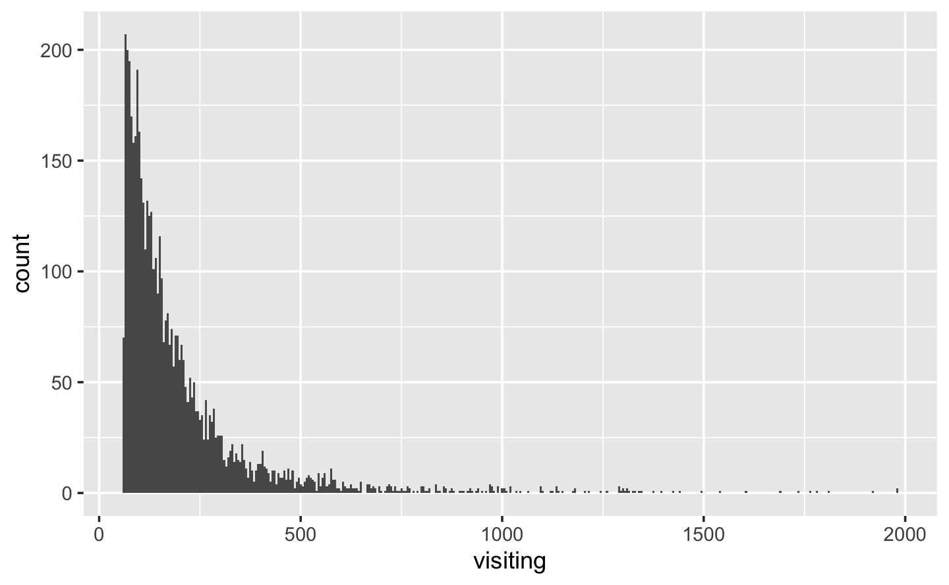
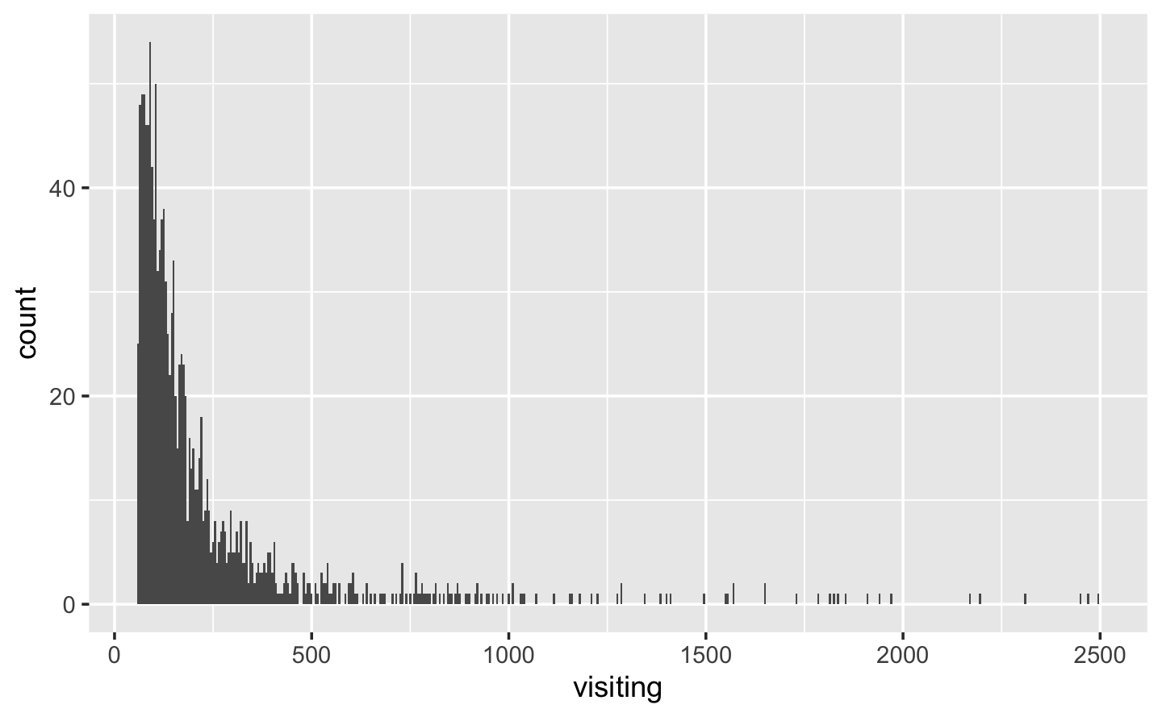
Data Cleaning
01 | Select columns from places and patterns datasets respectively, and merge according to placekey; filter NAICS_code 722511 & 722513, which represents full-service restaurant and limited-service restaurant
02 | Drop the rows with NA values in location_name; 837 rows are dropped from this step
03 | Use data_range_end to determine the month of each row and create a new column representing the month
04 | We selected [60, 2000] and [60, 2500] separately as threshold values for full-service restaurant and limited-service restaurant. 3663 rows are dropped from this step
05 | Originally there are 10762 rows in this dataset, After data cleaning, there are 6262 rows in total.

Slide 9
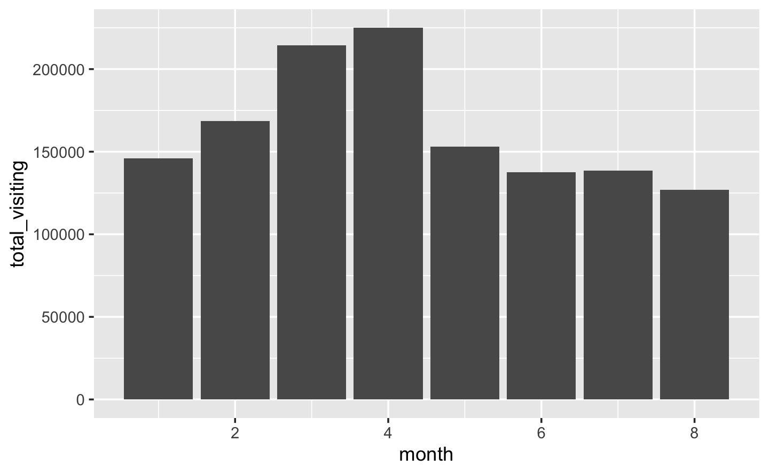
Patterns
01 Overall Trend
Policy 1
Policy 2
01 | Overall visiting number increased from Jan to Apr, and decreased ever since
02 | Stimulated by Policy 1, we observe a sharp increase from Feb to Mar

Slide 10
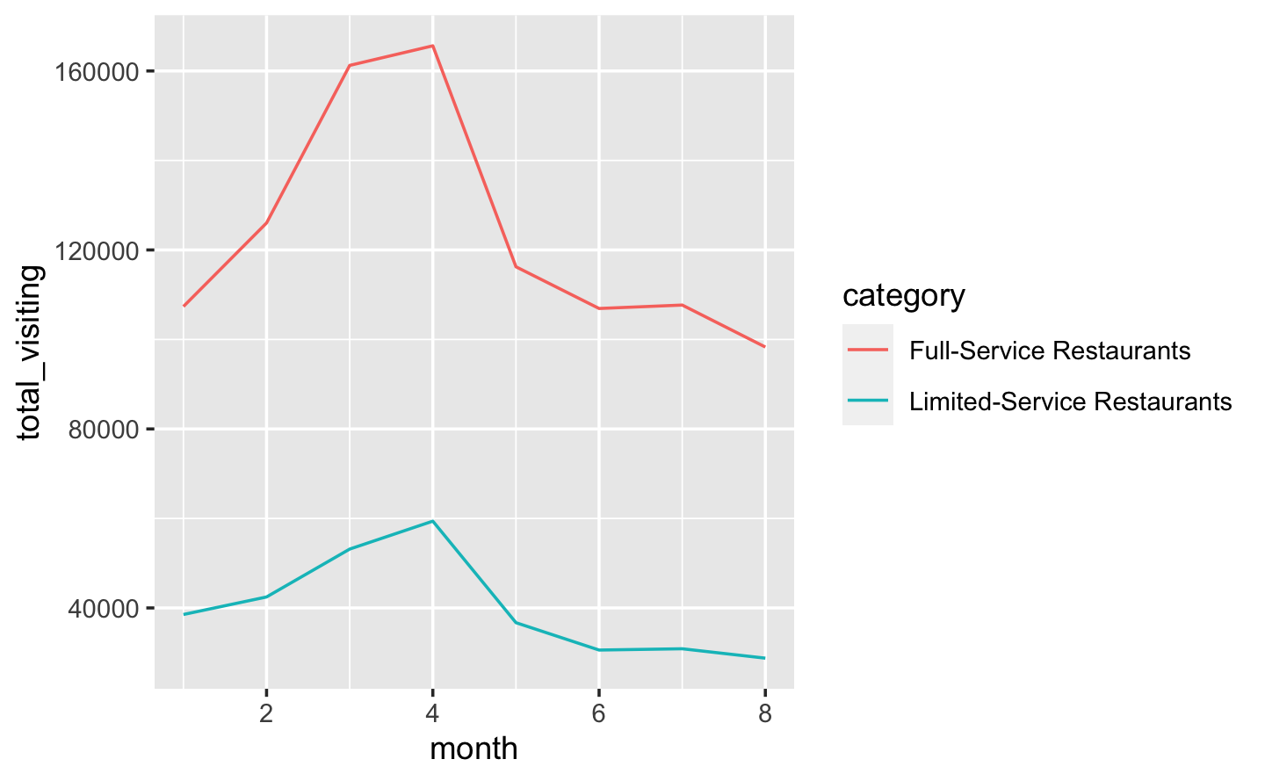
Patterns
02 Full & Limited
Policy 1
Policy 2
01 | Both follows the overall trend
02 | Spike of Full-service is more observable than that of Limited-Service

Slide 11
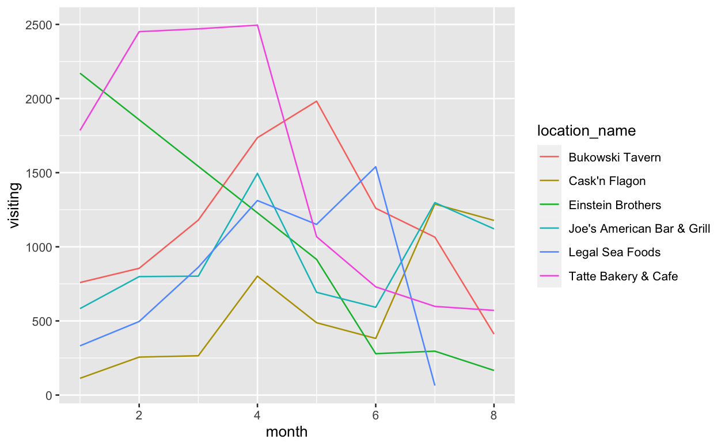
Patterns
03 Top 6 Stores
Trend
Policy 1
Policy 2
01 | Each color has the highest visiting at least one month.
02 | 4 data points are excluded

Slide 12
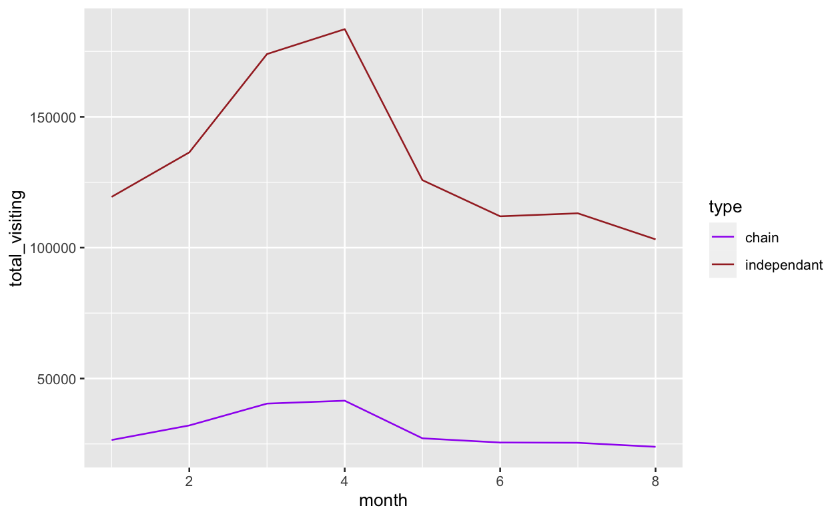
Patterns
04 Chain &
Independent
Policy 1
Policy 2
01 | Same pattern compared to overall trend
02 | Reach peak after 1.5 months

Slide 13
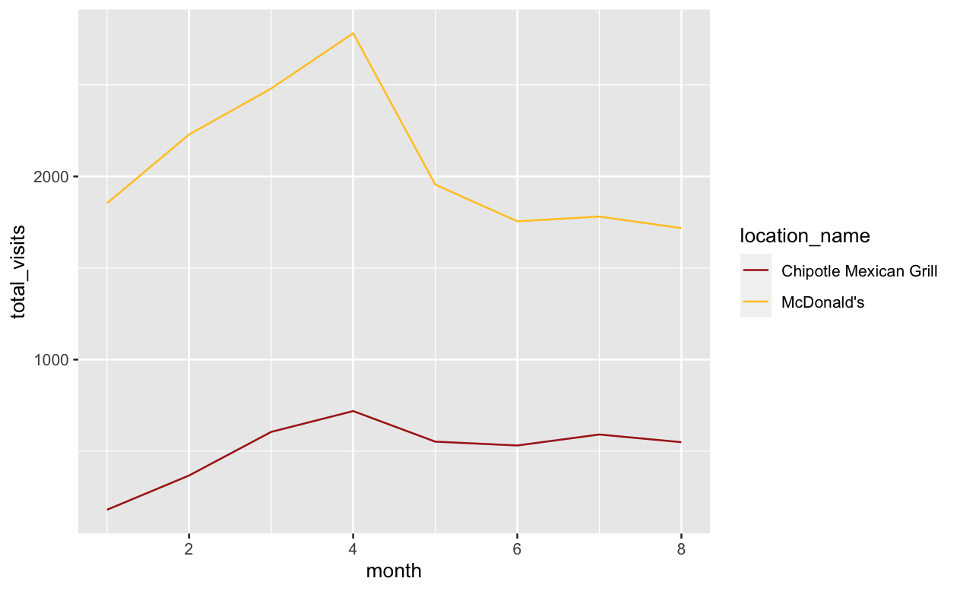
Patterns
05 Top Brands Analysis: Mcdonalds’ & Chipotle
Policy 1
Policy 2
01 | McDonald’s 7 stores
02 | Chipotle 6 stores

Slide 14
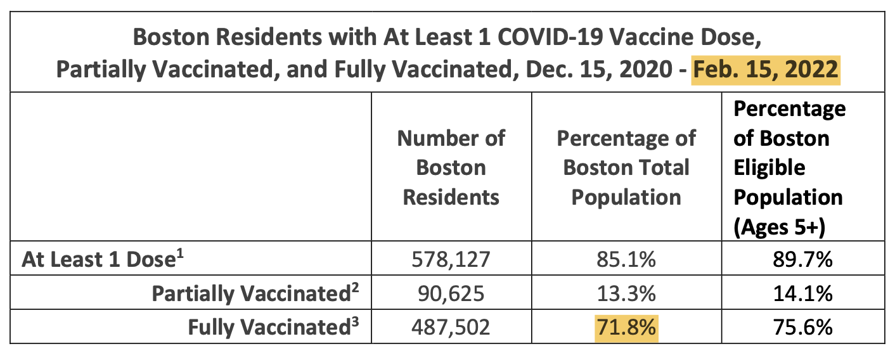
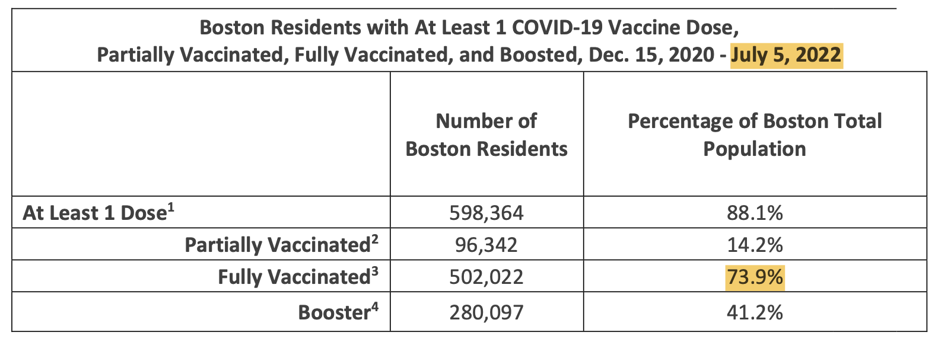
Patterns
05 Boston vaccination status
Q: Why no significant changes for the second policy effective in July?
A: According to boston.gov, over 70% of Boston residents are fully vaccinated, so the first policy has more significant impact.

Slide 15
Conclusion
Policy 1 has stronger effect on people’s behavior of visiting restaurants
Policy 2 does not bring a significant change on people’s dining behavior.
Seasonality
Vaccination rate
In conclusion, our alternative hypothesis on policy 1 is accepted, while we cannot reject the null hypothesis with a similar assumption on policy 2.

Slide 16
Challenges & Limitations
Seasonality: We cannot rule out the effect of seasonal variations in our data
Parentkey: Some restaurant share a same location
Chain and franchises: Some restaurants are chained but with only one store in Boston
Inactive restaurants and errors: restaurants with less than 60 visits per month; Some restaurants have missing data for certain months
Restaurant classification: Due to the effect of COVID-19, there could be more people choose to take-out and delivery; restaurant type may change

Slide 17

Future Applications
Since the COVID-19 epidemic is more serious in 2020 and 2021, we hope to apply our analysis method to the data of the previous two years in the future.
Moreover, we hope to compare the situation from year to year longitudinally, especially comparing pre-covid data, to exclude the influence of seasonality.
Notes:
Bullet point

Slide 18

References
Patterns Dataset: https://docs.safegraph.com/docs/monthly-patterns
Places Dataset: https://docs.safegraph.com/docs/places
Policies: https://www.mass.gov/lists/press-releases-related-to-covid-19
Boston Vaccination Data: https://www.boston.gov/government/cabinets/boston-public-health-commission/covid-19-boston#vaccination-reports-
Notes:
Boston map: https://stock.adobe.com/search?k=boston+map&asset_id=164610666
Covid vaccine:
https://www.nyclu.org/en/news/ny-cant-just-rely-vaccine-mandates
Restaurant:
https://www.cnn.com/travel/article/best-waterfront-restaurants-world/index.html

Slide 19
Thank you.

